Slide 1
Multifunctional Bi-Directional Person Counter
CS225/CS226 Project
Yash Sharma
1901CS73

Slide 2
INTRODUCTION
A Bi-Directional person counter is an Arduino device that is useful to monitor the number of persons inside any building. The device maintains the count of people who are inside the building and depending on its value various indicators can be used such as if the count is greater than 0 a led could be turned on and if the count exceeds a limit an alarm can be rung.

Slide 3
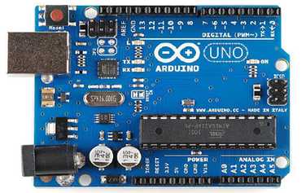
COMPONENTS REQUIRED
•Arduino Uno
•Two Ultrasonic Sensors
•LED
•Resistors
•Breadboard
•Jumper wires
•Power Source

Slide 4
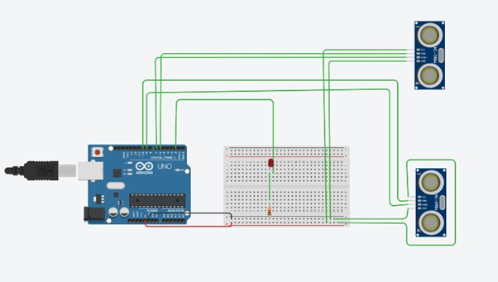
CIRCUIT DIAGRAM

Slide 5
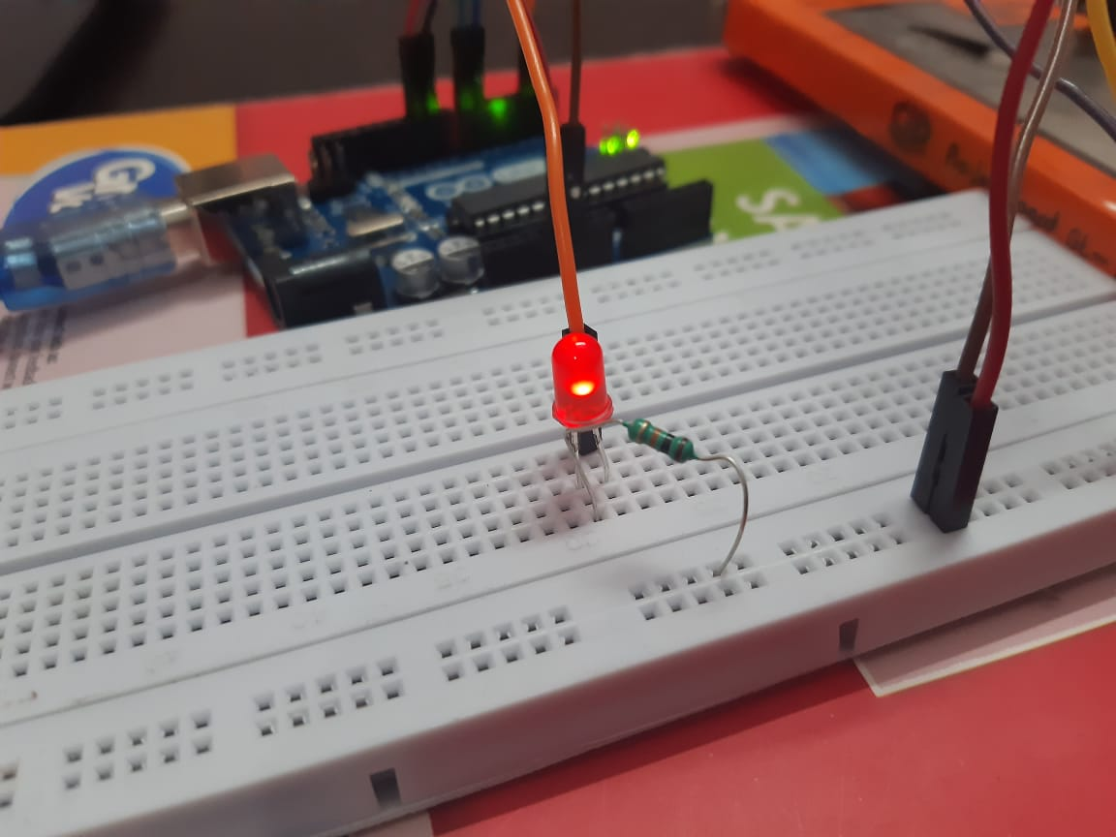
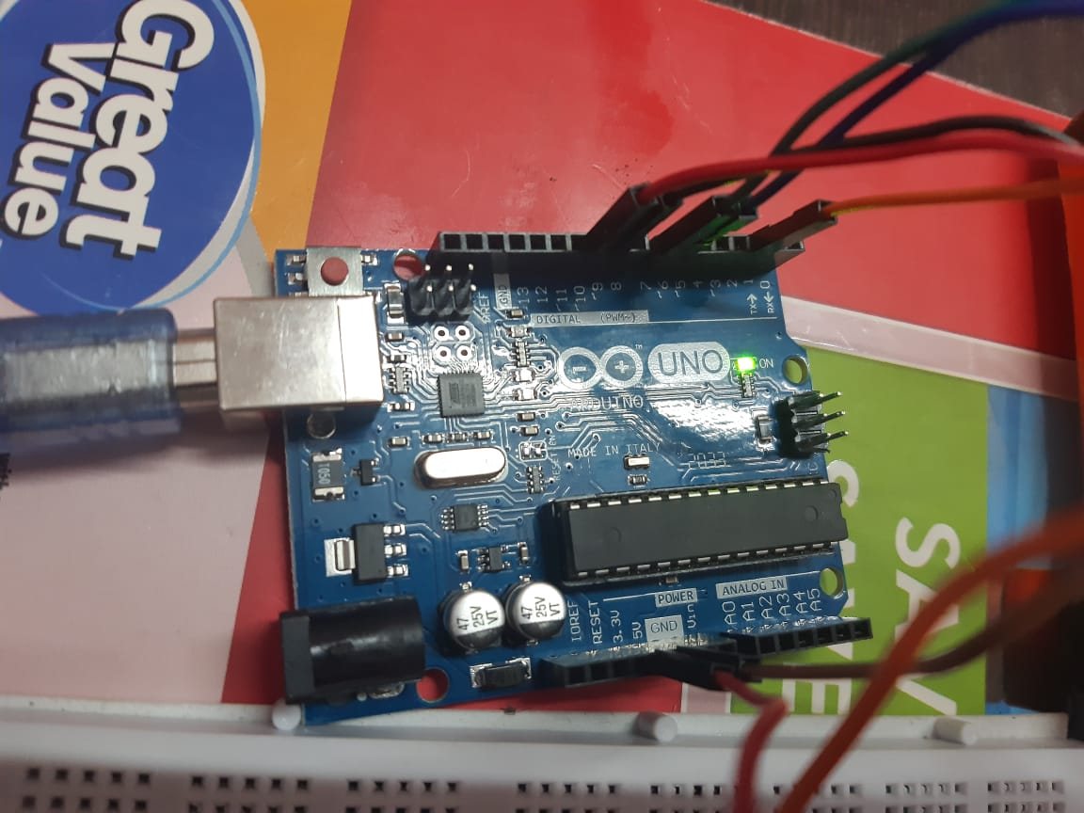
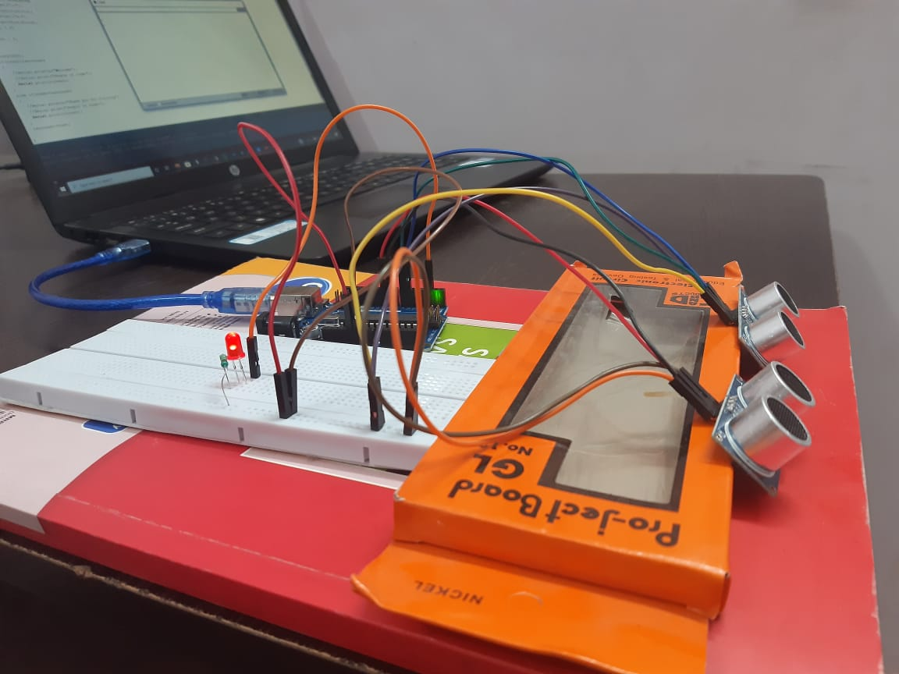

Slide 6
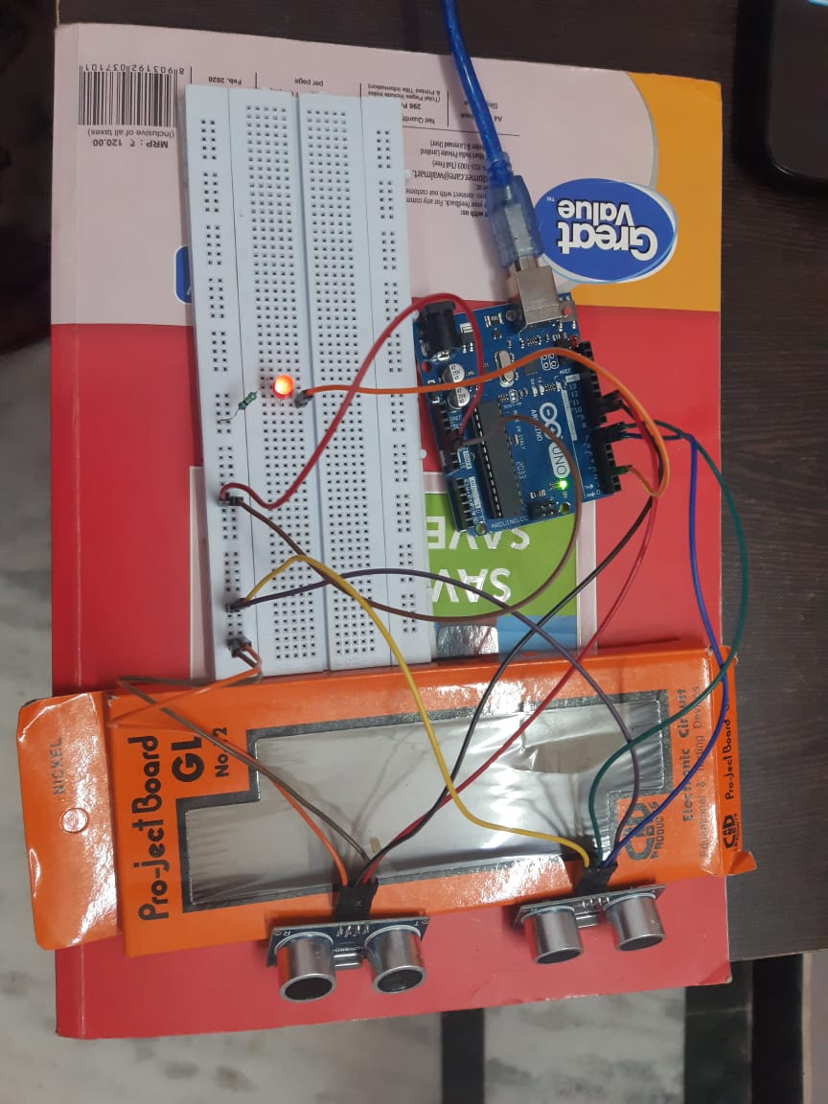
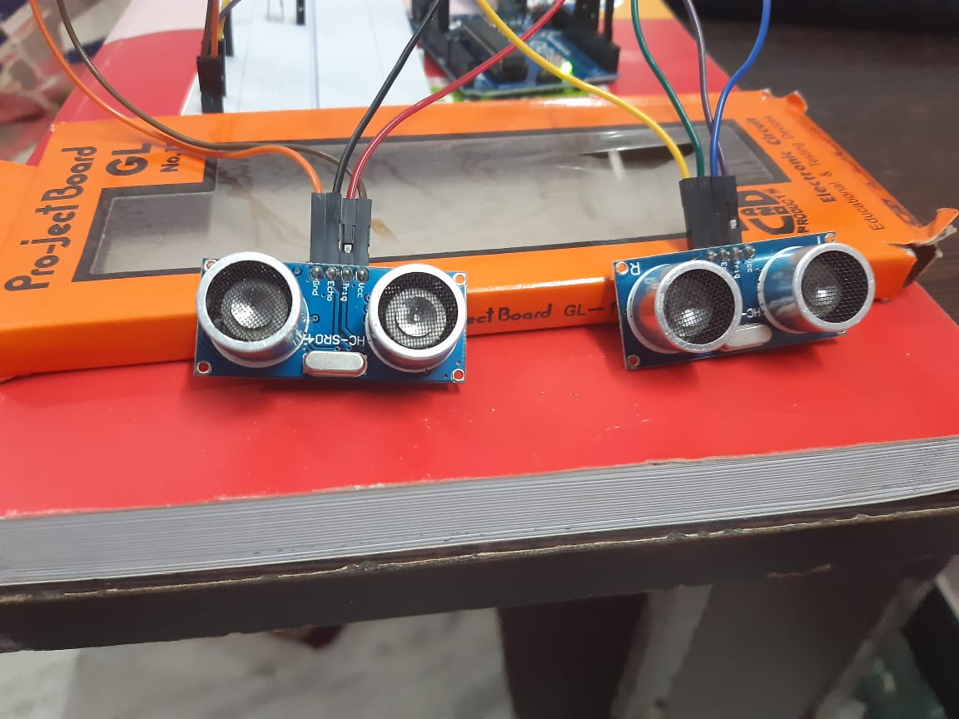
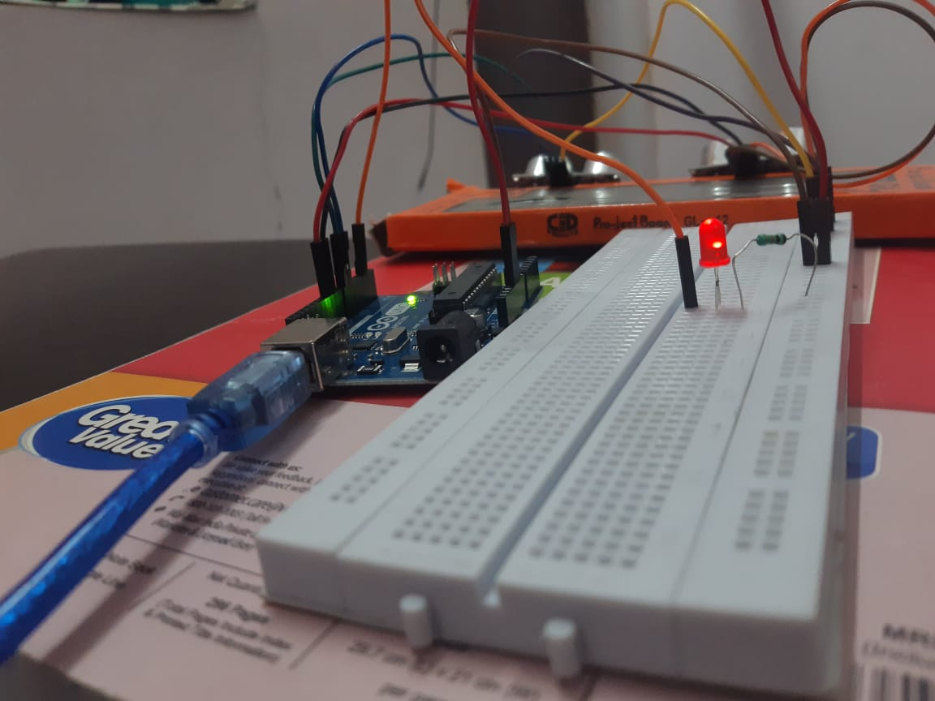

Slide 7
WORKING PROCESS
A variable ‘count’ initialized to 0 is used to store the current number of persons present inside a building. When a person enters the building, front ultrasonic sensor senses the object first followed by the rear sensor and the count is increased by 1 whereas when a person exits the building, the rear ultrasonic sensor senses the object first followed by the front sensor and the count is decreased by 1. An appropriate greeting message and the value of count is displayed on the Serial Monitor. When a person enters the building “Welcome” greeting message is shown and when a person leaves the building “Thank you for visiting” is shown. Also if the value of count is greater than 0 a LED glows.

Slide 8
APPLICATIONS AND FUTURE ASPECTS
This Arduino based project can have various applications namely:
It can be used in a mall/shop to continuously monitor the current number of visitors and find out the number of visitors as a function of time (using Serial Plotter) to know when is the maximum customer count and manage service accordingly.
It can be used in hospital to regulate the number of people waiting outside the doctor’s cabin. Using led, a patient can know if he/she can go inside cabin or not.
Overcrowding of the people can be controlled at busy places, party or rally.
An electrical appliance can be switched on or off automatically according to the count of the people. When there is no one inside, all appliances may be automatically switched off to save electricity.

Slide 9
THANK YOU!
It was a nice learning experience working on this project.

